Slide 1
Analysis on Car Accident Severity
AYUSH ANAND JHA

Slide 2

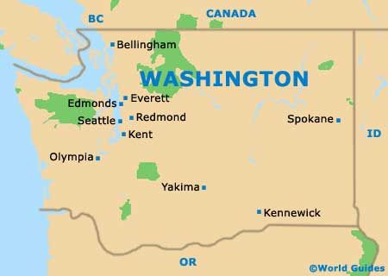
Introduction
The project is based on the dataset provided in the course of Applied Data Science Capstone of Road Accident occurred in Seattle
generated from https://data.seattle.gov/
This project is to take a glimpse at different accidents that occurred in Seattle City.
The objective of the project is to design a system that can be used to avoid or tackle any future occurrences of road accidents that can be caused due to several reasons based on past data.

Slide 3
Problem
The idea is to provide a pre-determined possibility of occurrence severe accident prior to the movement of the vehicles in traffic that can help several travelers who are keen to drive on a particular lane or highway.
Analysing a significant range of factors, including weather conditions, special events, roadworks, traffic jams among others, an accurate prediction of the severity of the accidents can be performed
this knowledge of a severe accident situation can be warned to driver so that they would drive more carefully or even change their route if it is possible or to hospital which could have set everything ready for a severe intervention in advance.

Slide 4
Who Are The Target Audience?
The daily travelers and drivers of the city
those who possess an interest in machine learning can use this project for research purposes
Anyone who is keen to try roads of the city would've the pre-determined possibility of encountering an accident
It can help them to avoid that path or drive to save time as well as life
Government should be highly interested in accurate predictions of the severity of an accident, in order to reduce the time of arrival and thus save a significant amount of people each year.
Others interested could be private companies investing in technologies aiming to improve road safety.

Slide 5
Data Acquisition
The data that will be used in the project is the one that is provided with the course 'Data-Collisons.csv' consist of 38 features as column and around 1.9 million records of accidents in rows.
These information can be obtained from Seattle Department of Transportation (SDOT). SDOT has an open data platform which can be found in “https://data.seattle.gov/”. In this platform, they update their information about collisions weekly. We can find all information we need in this dataset.
The attribute information details can be found in “https://www.seattle.gov/Documents/Departments/SDOT/GIS/Collisions_OD.pdf”

Slide 6
Data Preparation
The problem is predicting the severity code by using the independent variables. Hence, it is a classification problem. The "severity" depends on the following data:
Accident location: Latitude("Y" column - float), Longitude("X" column - float)
Road coditions: "ROADCOND" column - text
Weather condition: "WEATHER" column - text
Junction: "JUNCTIONTYPE" column - text
Car speeding: "SPEEDING" column - boolean
Number of people involved: "PERSONCOUNT" column - integer
Light conditions: "LIGHTCOND" column - text
Number of vehicles involved in: "VEHCOUNT" column - integer
The date time when the accident occurs: "INCDATE", "INCDTTM" columns - text

Slide 7
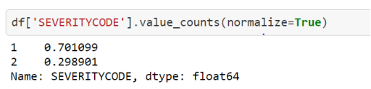
Data Preparation - Severity
We can see that the dataset contains only 2 severities: "1" (prop damage) and "2" (injury). It will limit the prediction because the classification can not perform with the label which doesn't exist in dataset such as "3" (fatality), "2b" (serious injury) and "0" (unknown).

Slide 8
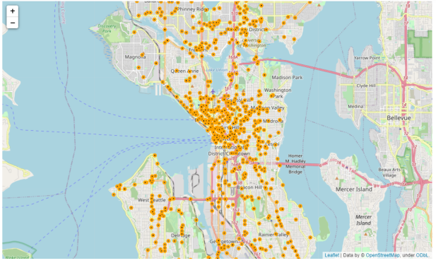
Map For Collision Distribution

Slide 9
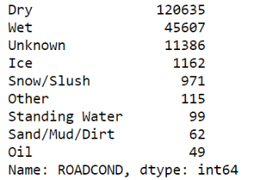
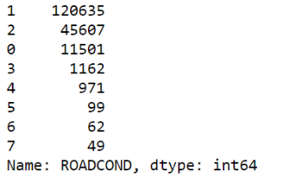
Data Preparation
We've to drop the missing value of the longitude and latitude in order to data preparation. Also later we’ve to encode the categorical data, one of the example is given below.
We’ll perform same operation for other attribute such as WEATHER, JUNCTIONTYPE, and LIGHTCOND.

Slide 10
Model Building and Evaluation
In this analysis we are going to used following models as we find our categorical:
1. K Nearest Neighbor (KNN)
2. Decision Tree
3. Logistic Regression
Evaluation is important as it shows the clear picture of how much efficient the models were after being trained and tested. In this project F1-Score and Jaccard Score are used as evaluation metrics.

Slide 11
Evaluation Table
Metrics / Models | KNN | Decision Tree | Logistic Regression
F1-Score | 0.64 | 0.66 | 0.62
Jaccard Score | 0.47 | 0.52 | 0.47

Slide 12
Results
From the above evaluation of different classification models, we can observe that F1-score of the different models didn't varied much, yet, Logistic Regression model was significantly better choice for the project (score = 0.62).
However, according to Jaccard Score both KNN and Logistic Regression equally suits the requirement with score of 0.47
It can be concluded that three models chosen for the development and evaluation are being studied and verified altogether.

Slide 13
Conclusion
The exploratory analyses of the extracted dataset and the models that were built in order to develop a proper system that can predict car severity for the intended target audience mentioned in previous section.
This project is also going to help individual in determining the best model among chosen ones.

